Slide 1
UNIT 4

Slide 2
What is Image Segmentation?
Image segmentation is the process of dividing an image into different regions based on similar properties such as:
Color
Intensity/brightness
Texture
Shape
For example, in a medical image, we may want to separate a tumor from healthy tissue.

Slide 3
What is Region Growing?
Region Growing is a simple image segmentation technique.
It starts with one or more selected pixels called seed points and grows the region by adding neighboring pixels that are sufficiently similar to the seed.
If the neighboring pixels have similar intensity, they are added to the region.
The process continues until no more suitable neighboring pixels are found.

Slide 4
Consider this small grayscale image:
10 12 11 80 85
11 13 12 82 88
10 12 14 81 86
50 52 55 90 92
Suppose our seed is: 13
and the threshold is:
Threshold = 5

Slide 5
We accept pixels whose intensity is within 5 of the seed:
Seed = 13
13 - 5 = 8
13 + 5 = 18

Slide 6
Therefore, values from approximately 8 to 18 can belong to the region.
1 1 1 0 0
1 1 1 0 0
1 1 1 0 0
0 0 0 0 0
1 belongs to the region
0 = does not belong to the region

Slide 7
Suppose our current pixel is (1,1):
(1,1) = 6
Its 4 neighbors are:
(1,0)
↑
|
(0,1) ← (1,1) → (2,1)
|
↓
(1,2)

Slide 8
neighbors = [(0,1), (2,1), (1,0), (1,2)]
nx = 0 ny = 1
So we are checking (0,1).
Is it inside the image?
if 0 <= nx < 3 and 0 <= ny < 3:
0 <= 0 < 3
0 <= 1 < 3

Slide 9
So it is inside.
Has it already been selected?
Suppose:
region =
0 0 0
0 1 0
0 0 0

Slide 10
The 1 means our current pixel is already selected.
region =
0 0 0
0 1 0
0 0 0

Slide 11
Graph-Cut Segmentation
Graph Cut is an image segmentation method that treats the image like a graph.
The pixels become nodes, and connections between neighboring pixels become edges.
Example: Separate an apple from the background
Imagine this image:

Slide 12
Background Apple
10 10 | 200 200
10 10 | 200 200
10 10 | 200 200
Here:
10 = background pixels
200 = apple pixels

Slide 13
Graph Cut converts this image into a graph.
Pixels become Nodes
● ─ ● ─ ●
│ │ │
● ─ ● ─ ●
│ │ │
● ─ ● ─ ●

Slide 14
● = pixel/node
Neighboring pixels are connected
The lines mean neighboring pixels are connected.
● ─ ●
│ │
● ─ ●
These connections are called edges.

Slide 15
Source and Sink
Graph Cut adds two special nodes:
SOURCE SINK
↓ ↓
Foreground Background

Slide 16
For our apple:
SOURCE → Apple pixels
SINK → Background pixels
The algorithm makes a CUT
Graph Cut looks at connections between neighboring pixels.
For example:
10 ─── 10 ─── 200 ─── 200

Slide 17
There is a big difference between 10 and 200.
So the connection between them becomes a good place to cut.
10 ─── 10 200 ─── 200
↑
CUT
But look at two similar pixels:10 ─── 10
They are very similar, so cutting between them is usually not desirable.

Slide 18
I want to separate foreground and background, but I should cut where the pixel difference is large and avoid cutting through similar pixels.
Graph Cut finds a boundary by choosing a cut through the pixel connections that gives the lowest overall cost, usually preferring strong intensity/color differences.

Slide 19
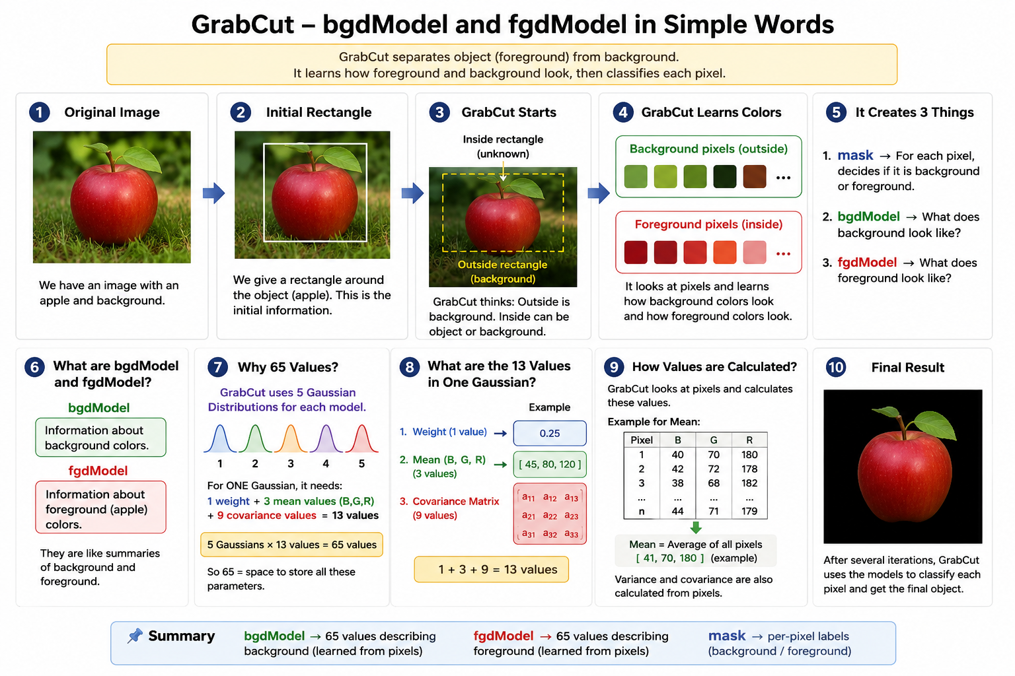

Slide 20
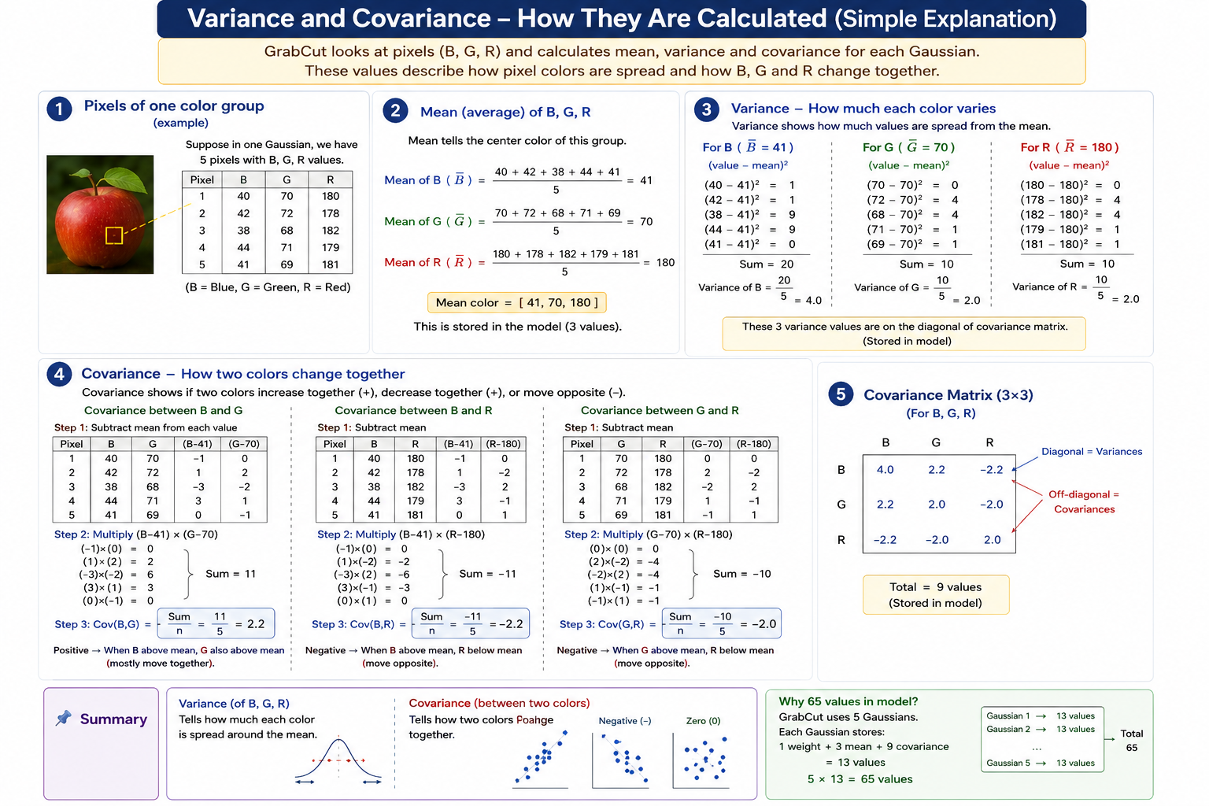

Slide 21
What is Mean Shift?
Mean Shift is a clustering algorithm.
Its basic idea is:
Look at nearby points → calculate their mean → move the window to that mean → repeat until the center stops moving.
It is called Mean Shift because the window keeps shifting toward the mean (the area with more points).
Image segmentation means dividing an image into meaningful groups/regions.

Slide 22
10 11 12 13 14
11 12 13 14 15
12 13 14 15 16
80 81 82 83 84
81 82 83 84 85

Slide 23
Region 1 → intensity around 10–16
Region 2 → intensity around 80–85
Suppose we start with a pixel having value:
X=13
and choose nearby pixels:
10,11,12,13,14,15

Slide 24

Their mean is:
$Mean=\frac{10+11+12+13+14+15}{6}$
Mean=12.5
So the point shifts:
13→12.5

Slide 25
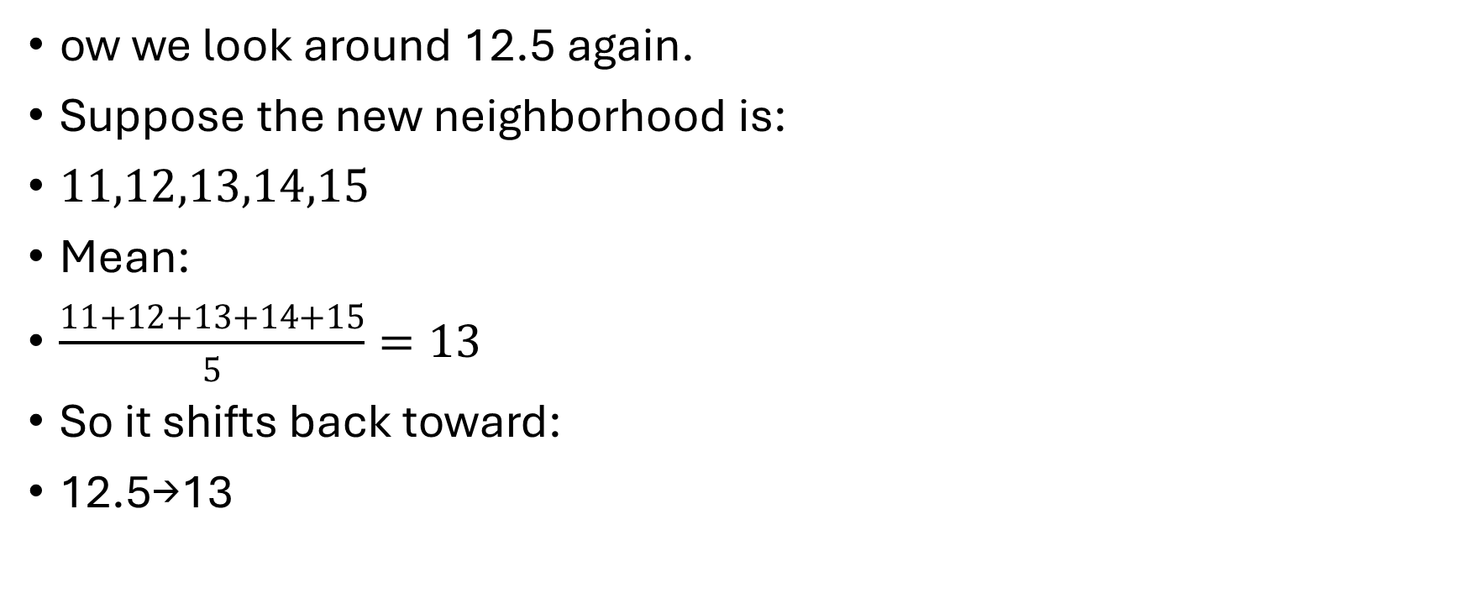
ow we look around 12.5 again.
Suppose the new neighborhood is:
$11,12,13,14,15$
Mean:
$\frac{11+12+13+14+15}{5}=13$
So it shifts back toward:
12.5→13

Slide 26
After several iterations, it converges around the center of that dense group.
A pixel starting around 82 would instead converge toward approximately 82.
Thus we get two clusters.
shifting” is the whole point of Mean Shift. We shift because we want to find the densest/similar group of pixels that a particular pixel belongs to.

Slide 27
stable point = convergence.
10 11 12 50
11 12 13 51
12 13 14 52
80 81 82 83

Slide 28
10 11 12
11 12 13
12 13 14
50 51 52
80 81 82 83

Slide 29
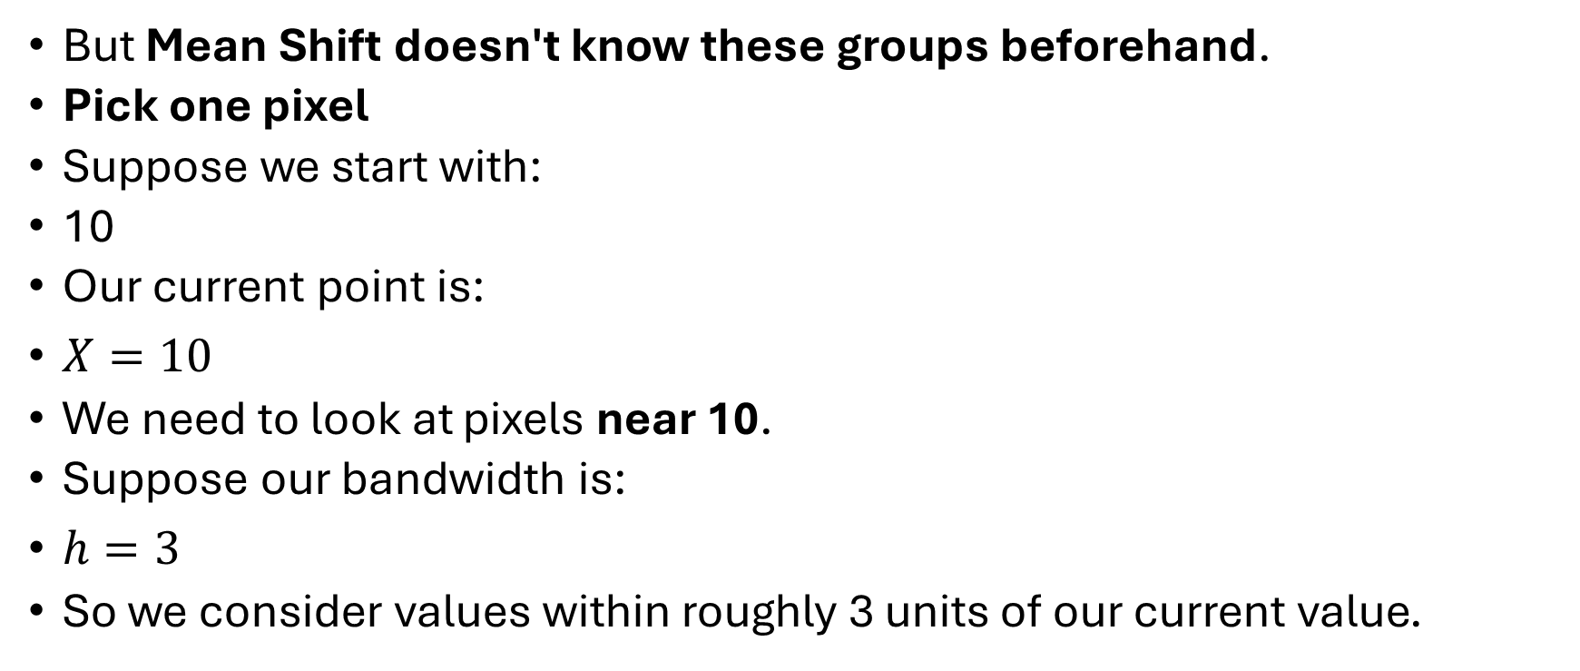
But Mean Shift doesn't know these groups beforehand.
Pick one pixel
Suppose we start with:
10
Our current point is:
$X=10$
We need to look at pixels near 10.
Suppose our bandwidth is:
$h=3$
So we consider values within roughly 3 units of our current value.

Slide 30

Around 10, we have:
10, 11, 11, 12
Step 2: Calculate the mean
Calculate their average:
$Mean=\frac{10+11+11+12}{4}$
$Mean=\frac{44}{4}$
$Mean=11$
So our new position becomes:
10→11

Slide 31
This is the first SHIFT.
Why did we shift?
Because the nearby pixels are centered around 11, not 10.
So we move toward the center of the nearby group.
Look around the NEW position
X=11
We again look at nearby pixels.

Slide 32

suppose we find:
10, 11, 11, 12, 12, 13
Calculate their mean:
$Mean=\frac{10+11+11+12+12+13}{6}$
$Mean=\frac{69}{6}$
$Mean=11.5$
So we shift again:
$11→11.5$

Slide 33

Step 4: Again
Now:
$X=11.5$
Look at nearby pixels again.
Suppose the nearby pixels are:
10, 11, 11, 12, 12, 13
Mean is still:
$11.5$
Therefore:
$11.5→11.5$
Nothing changes.

Slide 34

We have CONVERGED.
The point has reached a stable location:
$\boxed{11.5}$
We can call this a mode or density peak.
Mean Shift
↓
10 11 12 13 14 → Mode 1 ≈ 11.5
50 51 52 → Mode 2 ≈ 51
80 81 82 83 → Mode 3 ≈ 81.5

Slide 35
Segment 1 Segment 2 Segment 3
10 11 12 50 80
11 12 13 51 81
12 13 14 52 82
83

Slide 36
A = RGB(105, 148, 198) ← very similar
B = RGB(110, 155, 205) ← similar
C = RGB(140, 180, 220) ← more different
D = RGB(250, 20, 30) ← very different
Which nearby pixels have colors sufficiently close to my current color?“
So 21 asks "how far should I look?", while 51 asks "how different can the color be?"

